Slide 1
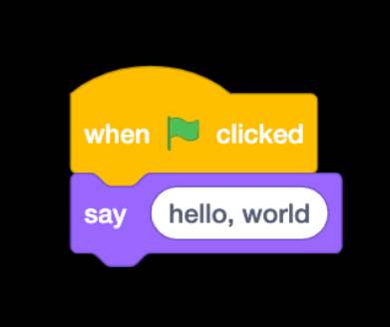
Introduction to C
Week 3
Sumaiyah Zahid

Slide 2
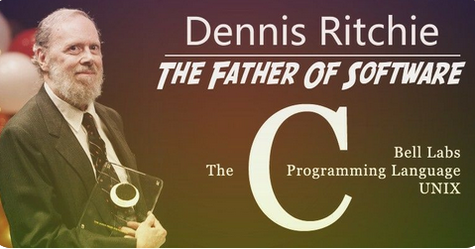
Why C?
Small size
Easy to learn
Structured language
Middle Level Language
Pointer implementation - extensive use of pointers for memory, array, structures and functions.

Slide 3
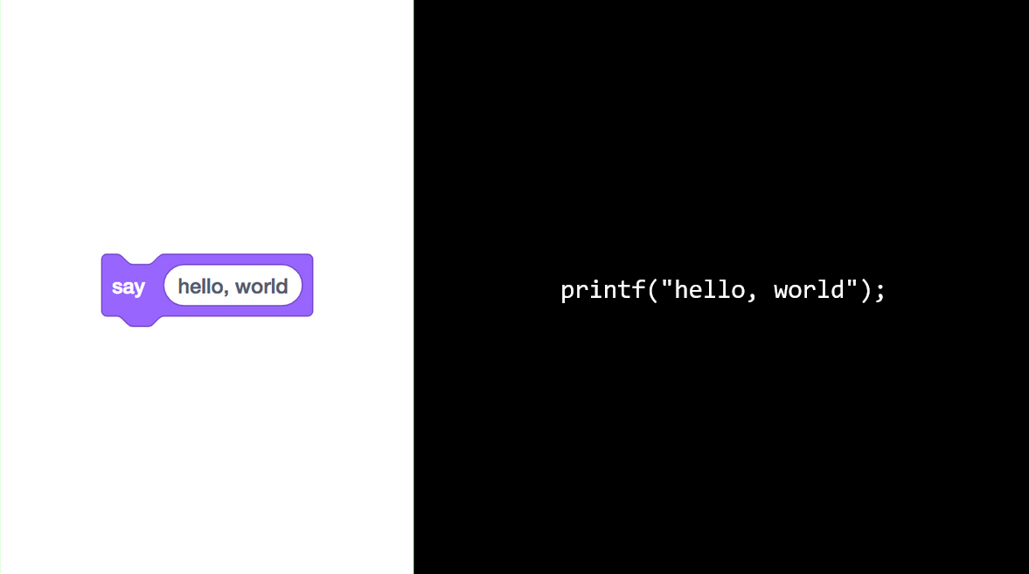

Slide 4
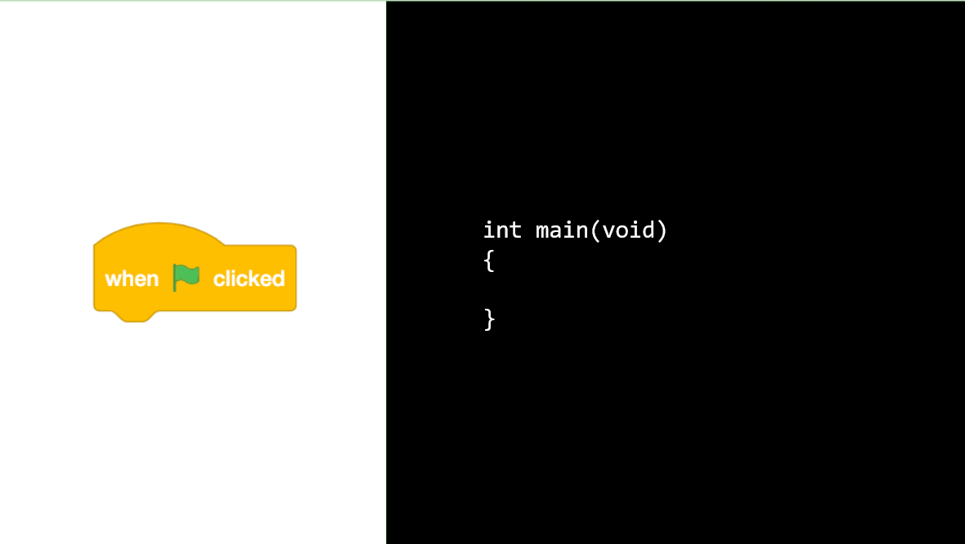

Slide 5
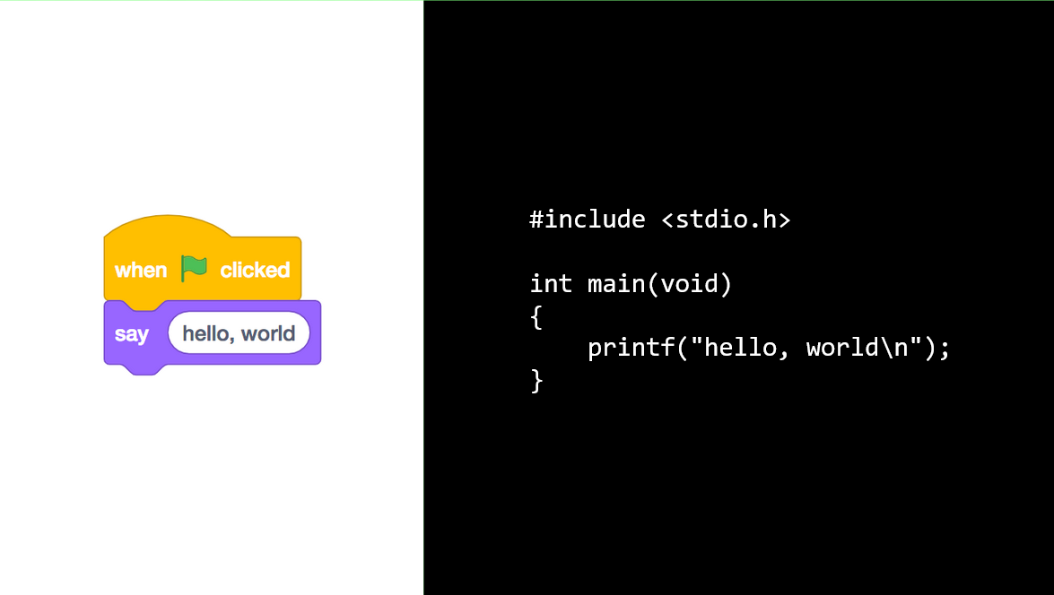

Slide 6
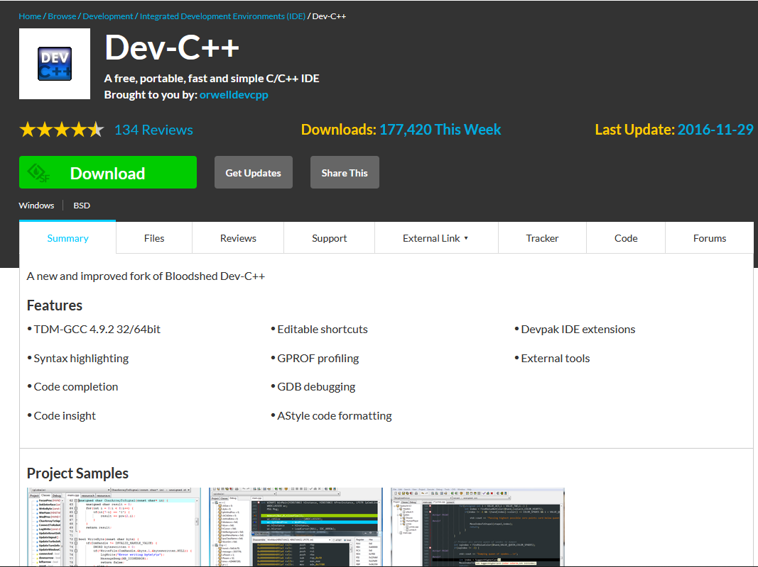
Desktop Application

Slide 7
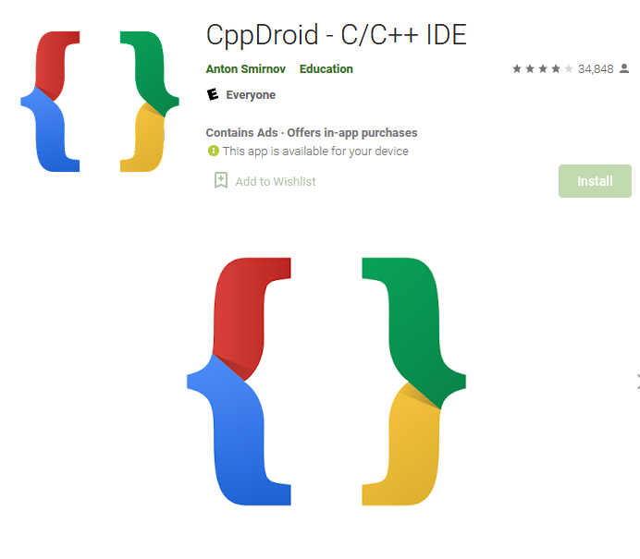
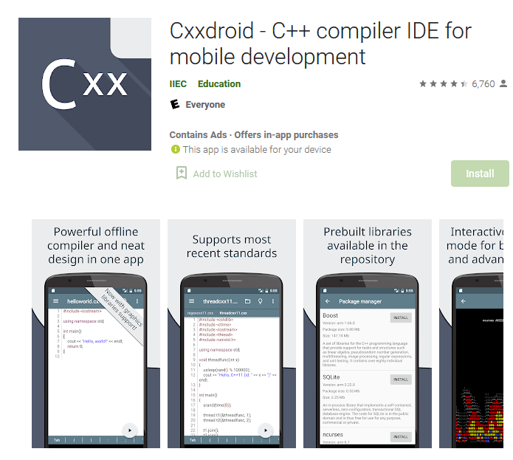
Android Applications

Slide 8
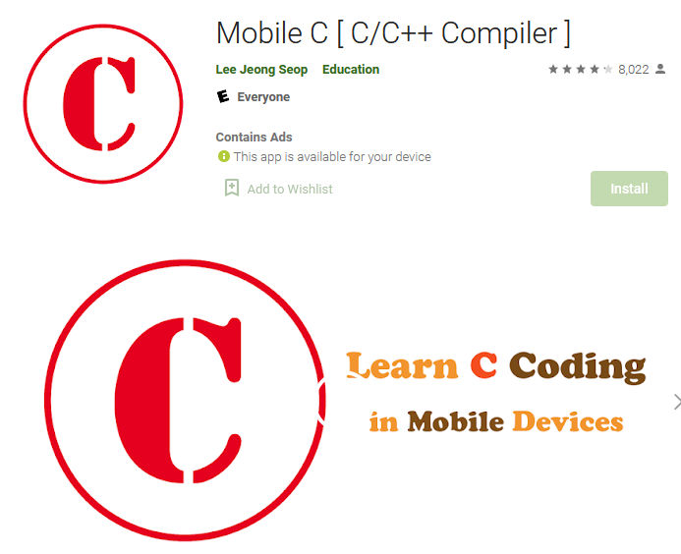
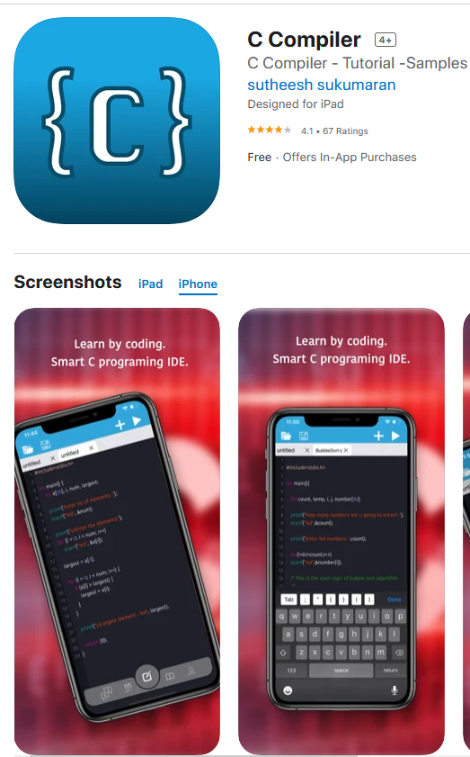
iPhone Applications

Slide 9
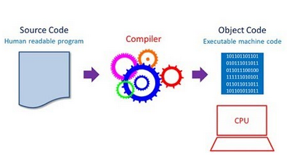

Slide 10
Writing a C program
A programmer uses a text editor to create or modify files containing C code.
Code is also known as source code.
A file containing source code is called a source file.
After a C source file has been created, the programmer must invoke the C compiler before the program can be executed (run).

Slide 11
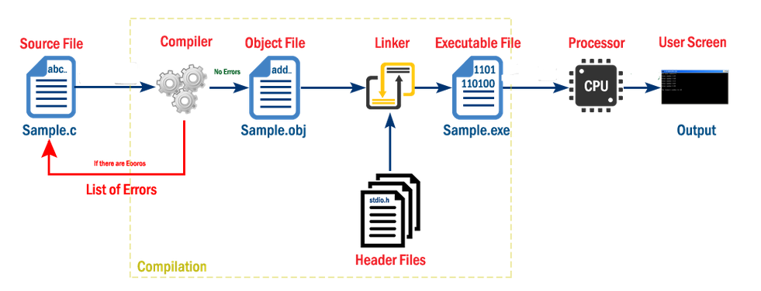
Architectural Diagram

Slide 12
Anatomy of C Program
/* This is my first program in C..
And this is a multi-line comment */
#include <stdio.h> // Header File for Input / Output
int main(void) // Main Function
{ // Braces showing start of Main
printf("Hello world!!!"); // Output Statement to print Hello World
return 0;
} // Braces indication end of Main

Slide 13
Program Header Comment
A comment is descriptive text used to help a reader of the program understand its content.
All comments must begin with the characters /* and end with the characters */
These are called comment delimiters
The program header comment always comes first.

Slide 14
Preprocessor Directives
Lines that begin with a # in column 1 are called preprocessor directives (commands).
Example: the #include <stdio.h> directive causes the preprocessor to include a copy of the standard input/output header file stdio.h at this point in the code.
This header file was included because it contains information about the printf ( ) function that is used in this program.

Slide 15
stdio.h
When we write our programs, there are libraries of functions to help us so that we do not have to write the same code over and over.
Some of the functions are very complex and long. Not having to write them ourselves make it easier and faster to write programs.
Using the functions will also make it easier to learn to program!

Slide 16
INT main (void)
Every program must have a function called main. This is where program execution begins.
main() is placed in the source code file as the first function for readability.
The reserved word “int” indicates that main() returns an integer.
The parentheses following the reserved word “main” indicate that it is a function.
The reserved word “void” means nothing is there.

Slide 17
The Function Body
A left brace (curly bracket) -- { -- begins the body of every function. A corresponding right brace -- } -- ends the function body.
The style is to place these braces on separate lines in column 1 and to indent the entire function body 3 to 5 spaces.

Slide 18
printf (“Hello World \n”);
This line is a C statement.
It is a call to the function printf ( ) with a single argument (parameter), namely the string “Hello, World!\n”.
Even though a string may contain many characters, the string itself should be thought of as a single quantity.
Notice that this line ends with a semicolon. All statements in C end with a semicolon.

Slide 19
return 0;
In C programs the main function is of type int and therefore it should return an integer value. The return value of the main function is considered the "Exit Status" of the application.
On most operating systems returning 0 is a success status like saying "The program worked fine".

Slide 20
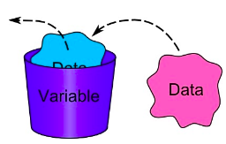
Variables
A variable is a space in the computer’s memory set aside for a certain kind of data and given a name for easy reference.
Variable Declaration
e.g: int x,y,z;
float a,b,c;
char z;

Slide 21

Variables
Declaration:
int x;
Initialization:
x=0;
Declaration & Initialization:
int x=0;

Slide 22
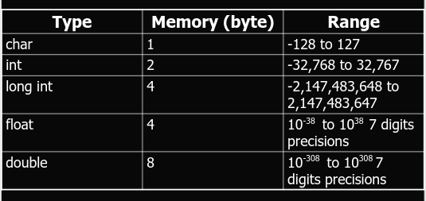
Variables Types

Slide 23
Constant Variables
In C/C++ program we can define constants in two ways as shown below:
Using #define preprocessor directive
#define identifierName value
#define a 5
Using a const keyword
const int a =5; // choose any one
int const a=5;

Slide 24

printf(“Your variable is %d”, myvariable);

Slide 25
printf()
The printf function has a special formatting character (%) -- a character following this defines a certain format for a variable:
%c – characters
%d – integers
%f – floats
e.g.
printf(``%c %d %f'',ch,i,x);
NOTE: Format statement enclosed in ``...'', variables follow after. Make sure order of format and variable data types match up.

Slide 26
Format Specifier
%c Single Character
%s String
%d Signed decimal integer
%f Floating point (decimal notation)
%e Floating point (exponential notation)
%u Unsigned decimal integer
%x Unsigned hexadecimal integer
%o Unsigned octal integer
l prefix used with %d, %u, %x, %o to specify long integer (e.g. %ld) %lf long double

Slide 27
Example
# include <stdio.h>
int main (void)
{
int event = 5;
char heat = ‘C’;
float time = 27.25;
printf(“ The winning time in heat %c”, heat);
printf(“ of event %d was %.2f”, event, time);
}

Slide 28
Escape Sequence
The following list shows the common escape sequences:
\n New line
\t Tab
\b Backspace
\r Carriage return
\f Form feed
\’ Single quote
\” Double quote
\\ Backslash

Slide 29
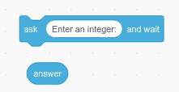
int answer;
printf(“Enter an integer”);
scanf(“%d”, &answer);

Slide 30
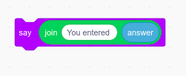
printf(“You entered %d”, answer);

Slide 31
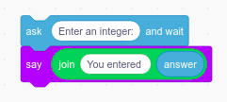
int answer;
printf(“Enter an integer”);
scanf(“%d”, &answer);
printf(“You entered %d”, answer);

Slide 32
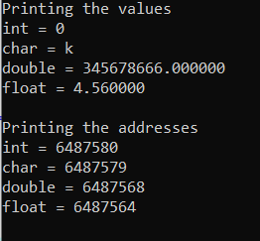
#include <stdio.h>
int main()
{
int a=0;
char b='k';
double c=345678666;
float d=4.56;
printf("Printing the values\n");
printf("int = %d\nchar = %c\ndouble = %lf\nfloat = %f\n",a,b,c,d);
printf("Printing the addresses\n");
printf("int = %d\nchar = %d\ndouble = %d\nfloat = %d \n", &a, &b, &c, &d);
return 0;
}

Slide 33
Example
#include<stdio.h>
int main(void)
{
int num1,num2,res;
printf(“Enter First Number: “);
scanf(“%d”,&num1);
printf(“Enter Second Number: “);
scanf(“%d”,&num2);
res=num1+num2;
printf(“The sum of two numbers is: %d”, res);
}

Slide 34
Practise Exercise
Write a program that asks the user to enter two numbers, obtains them from the user and prints their sum, product, difference, quotient and remainder.

Slide 35
#include <stdio.h>
int main()
{
int a,b, c;
printf("Enter First Number: ");
scanf("%d",&a);
printf("Enter Second Number: ");
scanf("%d",&b);
c = a+b;
printf("a+b = %d \n",c);
c = a-b;
printf("a-b = %d \n",c);
c = a*b;
printf("a*b = %d \n",c);
c = a/b;
printf("a/b = %d \n",c);
c = a%b;
printf("Remainder when a divided by b = %d \n",c);
return 0;
}
}

Slide 36
Operators
“Operators are words or symbols that cause a program to do something to variables.”

Slide 37
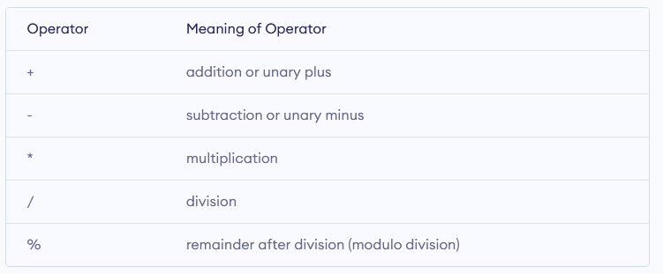
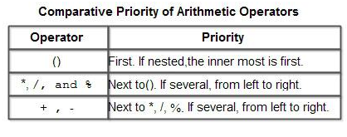
Arithmetic Operators
Precedence

Slide 38
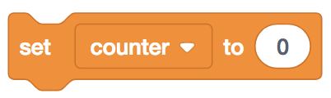
int counter = 0;

Slide 39
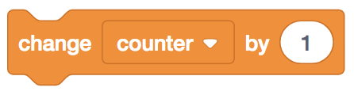
counter = counter + 1;

Slide 40
counter += 1;

Slide 41
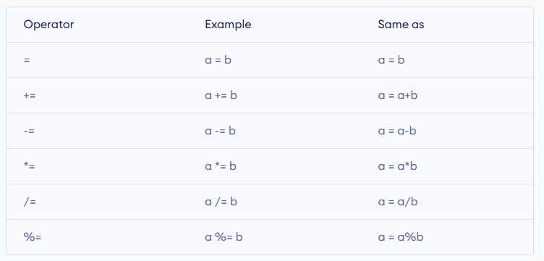
Assignment Operators

Slide 42
#include <stdio.h>
int main()
{
int a = 5, c;
c = a; // c is ?
printf("c = %d\n", c);
c += a; // c is ?
printf("c = %d\n", c);
c -= a; // c is ?
printf("c = %d\n", c);
c *= a; // c is ?
printf("c = %d\n", c);
c /= a; // c is ?
printf("c = %d\n", c);
c %= a; // c = ?
printf("c = %d\n", c);
return 0;
}

Slide 43
counter++;

Slide 44
Increment Decrement Operator
Increment ++ increases the value by 1
Decrement -- decreases the value by 1.
These two operators are unary operators, meaning they only operate on a single operand.
int a=5, b;
Post Increment b = a++; // b=5 a=6
Pre Increment b = ++a; // b=6 a=6

Slide 45
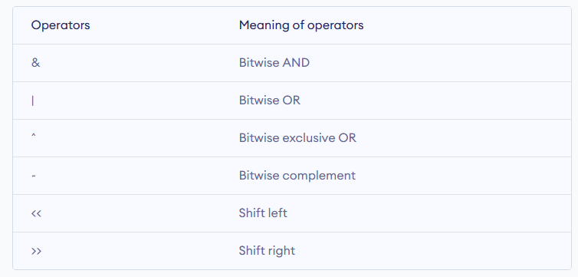
Bitwise Operator

Slide 46
Practise Exercise
Given as input an integer number of seconds, print as output the equivalent time in hours, minutes and seconds.
e.g:
7322 seconds is equivalent to 2 hours 2 minutes 2 seconds.
If a five-digit number is input through the keyboard, write a program to calculate the sum of its digits.
(Hint: Use the modulus operator ‘%’)

Slide 47
Practise Exercise
Two numbers are input through the keyboard into two locations C and D. Write a program to interchange the contents of C and D.

Slide 48
Home Assignment
Do Read thoroughly and practice all exercises of 1st chapter of “Let us C”
Ramesh’s basic salary is input through the keyboard. His dearness allowance is 40% of basic salary, and house rent allowance is 20% of basic salary. Write a program to calculate his gross salary.
Temperature of a city in Fahrenheit degrees is input through the keyboard. Write a program to convert this temperature into Centigrade degrees.
The length & breadth of a rectangle and radius of a circle are input through the keyboard. Write a program to calculate the area & perimeter of the rectangle, and the area & circumference of the circle.
If a four-digit number is input through the keyboard, write a program to obtain the sum of the first and last digit of this number.

